Slide 1



UNIVERSITY INSTITUTE OF ENGINEERING
COMPUTER SCIENCE ENGINEERING
Bachelor of Engineering
Design and Analysis of Algorithms(CST-311/ITT-311)
Topic: Euclid Algoirthm GCD, Modulo airthmetic, Chinese Remainder Theorem
DISCOVER . LEARN . EMPOWER

Slide 2
Learning Objectives & Outcomes
Objective:
To understand the concept of Euclid GCD, Modulo airthmetic, Chinese Remainder Theorem
Outcome:
Student will understand
Concept of Euclid GCD
Modulo airthmetic
Chinese Remainder Theorem

Slide 3
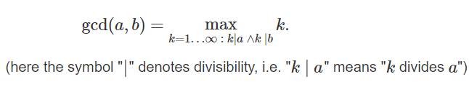
Euclidean Algorithm for Greatest Common Divisor (GCD)
Given two non-negative integers aa and bb, we have to find their GCD (greatest common divisor), i.e. the largest number which is a divisor of both aa and bb. It's commonly denoted by gcd(a,b). Mathematically it is defined as:

Slide 4
Pseudo Code of the Algorithm
Step 1: Let a, b be the two numbers
Step 2: a mod b = R
Step 3: Let a = b and b = R
Step 4: Repeat Steps 2 and 3 until a mod b is greater than 0
Step 5: GCD = b
Step 6: Finish

Slide 5
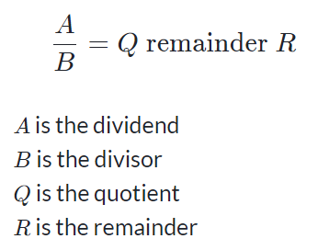
Modular arithmetic
When we divide two integers we will have an equation that looks like the following:
Sometimes, we are only interested in what the remainder is when we divide A by B.
For these cases there is an operator called the modulo operator (abbreviated as mod).
Using the same A, B, Q, and R as above, we would have: A mod B = R.
We would say this as A modulo B is equal to R. Where B is referred to as the modulus.

Slide 6
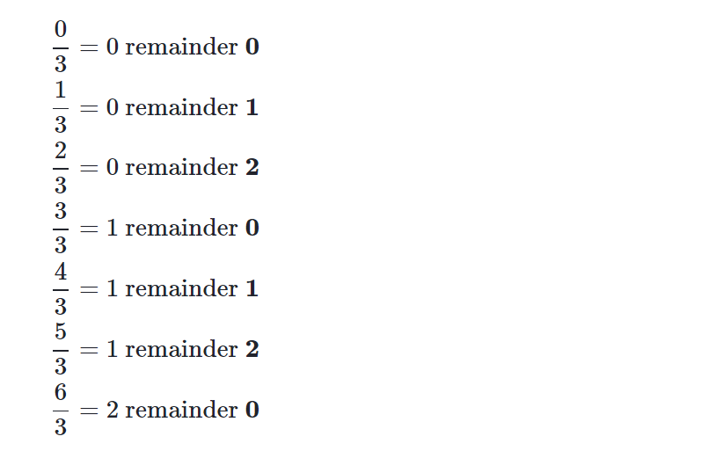
Visualize modulus with clocks
Observe what happens when we increment numbers by one and then divide them by 3.

Slide 7
Visualize modulus with clocks (Contd.)
The remainders start at 0 and increases by 1 each time, until the number reaches one less than the number we are dividing by. After that, the sequence repeats.
By noticing this, we can visualize the modulo operator by using circles.
We write 0 at the top of a circle and continuing clockwise writing integers 1, 2, ... up to one less than the modulus.

Slide 8
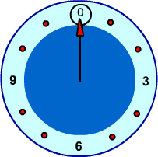
Visualize modulus with clocks (Contd.)
For example, a clock with the 12 replaced by a 0 would be the circle for a modulus of 12.
To find the result of A mod B we can follow these steps:
Construct this clock for size B
Start at 0 and move around the clock A steps
Wherever we land is our solution.
(If the number is positive we step clockwise, if it's negative we step counter-clockwise.)

Slide 9
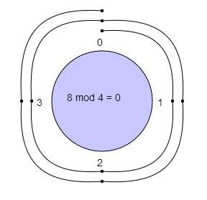
Examples
8 mod 4=?
With a modulus of 4 we make a clock with numbers 0, 1, 2, 3.
We start at 0 and go through 8 numbers in a clockwise sequence 1, 2, 3, 0, 1, 2, 3, 0.
We ended up at 0 so 8 mod 4 = 0

Slide 10
Chinese Remainder Theorem
We are given two arrays num[0..k-1] and rem[0..k-1]. In num[0..k-1], every pair is coprime (gcd for every pair is 1). We need to find minimum positive number x such that:
x % num[0] = rem[0],
x % num[1] = rem[1],
.......................
x % num[k-1] = rem[k-1]
Basically, we are given k numbers which are pairwise coprime, and given remainders of these numbers when an unknown number x is divided by them. We need to find the minimum possible value of x that produces given remainders.

Slide 11
Examples
Input: num[] = {3, 4, 5}, rem[] = {2, 3, 1}
Output: 11
Explanation:
11 is the smallest number such that:
When we divide it by 3, we get remainder 2.
When we divide it by 4, we get remainder 3.
When we divide it by 5, we get remainder 1.

Slide 12
REFERENCES
Text books:
Cormen, Leiserson, Rivest, Stein, “Introduction to Algorithms”, Prentice Hall of India, 3rd edition 2012. problem, Graph coloring.
Websites:
https://www.khanacademy.org/computing/computer-science/cryptography/modarithmetic/a/what-is-modular-arithmetic
https://www.geeksforgeeks.org/chinese-remainder-theorem-set-1-introduction/

Slide 13
Summary
  Miscellaneous Topic:
    Concept of Euclid GCD
    Modulo airthmetic
    Chinese Remainder Theorem

Slide 14
THANK YOU

